Slide 1

Hardware Implementation of Relay Control with Enhanced Autotune Identification Using Machine Learning
M.Tech Thesis Presentation
Thesis Supervisor
Prof. Somanath Majhi
Dept. of EEE, IIT Guwahati
Presented by
Manish Kumar
Dept. of EEE, IIT Guwahati

Slide 2

Presentation Outline
Introduction
Literature Survey
Objective
Identification Technique
Hardware Implementation
Data Generation & Analysis
Methodology & Algorithms
Results
Conclusion and Future Scope
References
4th June 2024
Dept. of EEE, IIT Guwahati
2

Slide 3
Introduction
Identification of Dynamic Model of Plants
Time Domain
Based
Identification
Frequency Domain
Based
Identification
4th June 2024
Dept. of EEE, IIT Guwahati
3

Slide 4
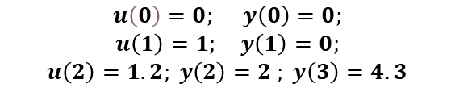
Time Domain Based Identification
Measure plant i/p & o/p
Establish a model structure very sensitive to measurement errors
Suppose: $y\left(n\right)=ay\left(n−1\right)+bu\left(n−1\right)$
Identification of plant => estimating accurate $a \& b$ values.
Suppose ,
$$u\left(0\right)=0; y\left(0\right)=0;$$
$$u\left(1\right)=1; y\left(1\right)=0;$$
$$u\left(2\right)=1.2; y\left(2\right)=2 ; y\left(3\right)=4.3$$
Plant parameters estimated as : $a=0⋅95 \& b=2$
4th June 2024
Dept. of EEE, IIT Guwahati
4

Slide 5
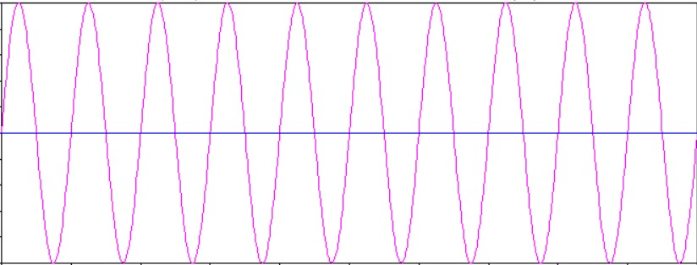

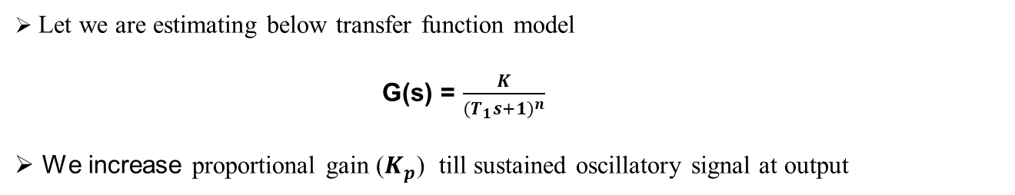
Frequency Domain Based Identification
G(s)
O/P
$$K_{p}$$
A
Figure 1: Proportional controller based identification
T
Let we are estimating below transfer function model
G(s) = $\frac{K}{{(T_{1}s+1)}^{n}}$
We increase proportional gain ($K_{p}$) till sustained oscillatory signal at output
4th June 2024
Dept. of EEE, IIT Guwahati
5

Slide 6
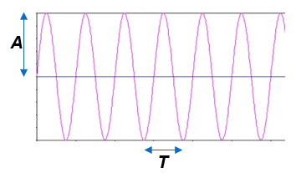
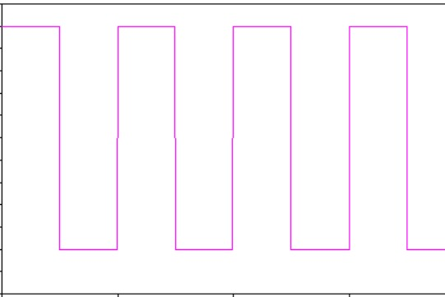
Relay Control System
R
E
U
Y
G(s)
+h
Relay
Process
-h
Figure 2:Conventional Relay Control System
Proportional controller is replaced by a symmetrical relay.
Relay ensures the sustained oscillatory limit cycle output.
It identifies the process information around the important frequency, the ultimate frequency.
From the relay control system , it is a closed loop test. Therefore, the process will not drift away from the nominal operating point.
4th June 2024
Dept. of EEE, IIT Guwahati
6

Slide 7
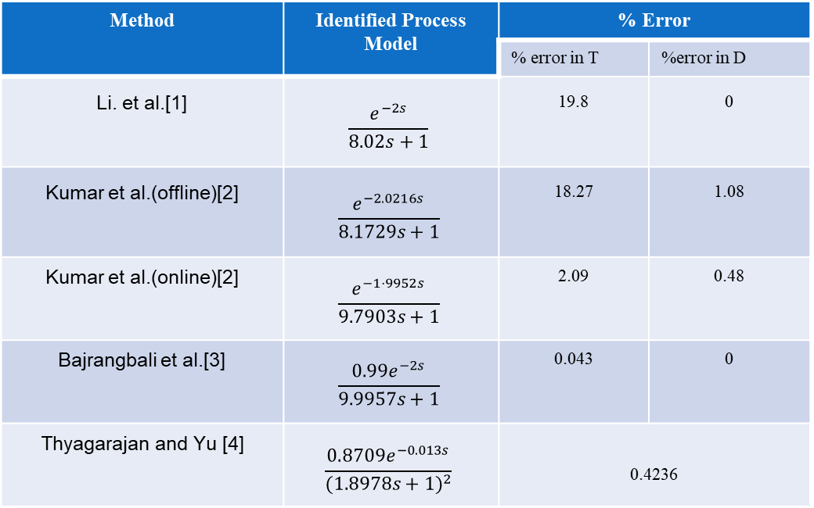
Literature Survey
Method | Identified Process Model | % Error
 |  | % error in T | %error in D
Li. et al.[1] | $$\frac{ⅇ^{−2s}}{8.02s+1}$$ | 19.8 | 0
Kumar et al.(offline)[2] | $$\frac{ⅇ^{−2.0216s}}{8.1729s+1}$$ | 18.27 | 1.08
Kumar et al.(online)[2] | $$\frac{ⅇ^{−1⋅9952s}}{9.7903s+1}$$ | 2.09 | 0.48
Bajrangbali et al.[3] | $$\frac{0.99ⅇ^{−2s}}{9.9957s+1}$$ | 0.043 | 0
Thyagarajan and Yu [4] | $$\frac{0.8709ⅇ^{−0.013s}}{{(1.8978s+1)}^{2}}$$ | 0.4236
4th June 2024
Dept. of EEE, IIT Guwahati
7

Slide 8
Literature Survey
Research Gap
From the above literature survey, we can conclude that the research gap lies in the lack of discussion on the practical implementation challenges of relay-based identification techniques in real-world systems.
Researchers predominantly use simulation studies to enhance model accuracy until they reach a point where further improvements are not achievable.
There is a need for novel approaches or techniques with real-time systems beyond traditional simulation methods to improve accuracy in relay control system-based identification.
4th June 2024
Dept. of EEE, IIT Guwahati
8

Slide 9
Objective
A hardware system similar to a relay control system with transportation delay is designed.
Real-time data from the hardware model is used to train the machine learning model.
Enhancing autotune identification with machine learning models.
4th June 2024
Dept. of EEE, IIT Guwahati
9

Slide 10
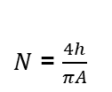
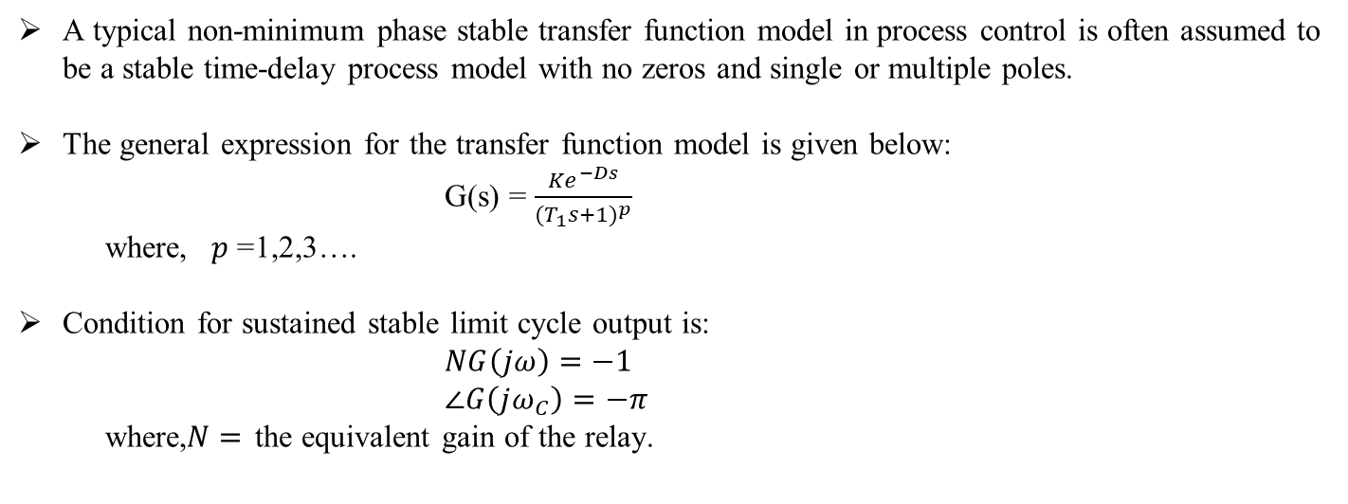
Identification Technique
A typical non-minimum phase stable transfer function model in process control is often assumed to be a stable time-delay process model with no zeros and single or multiple poles.
The general expression for the transfer function model is given below:
G(s) = $\frac{{Ke}^{−Ds}}{{(T_{1}s+1)}^{p}}$
where, $p$ =1,2,3….
Condition for sustained stable limit cycle output is:
$NG\left(jω\right)=−1$
$∠G\left(jω_{C}\right)=−π$
where,$N=$ the equivalent gain of the relay.
$N$ = $\frac{4h}{πA}$
4th June 2024
Dept. of EEE, IIT Guwahati
10

Slide 11
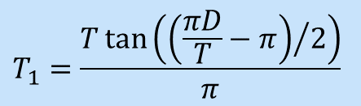
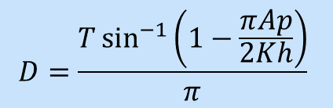
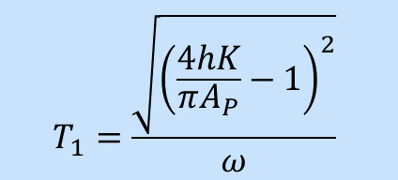
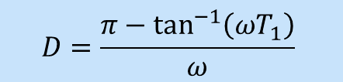
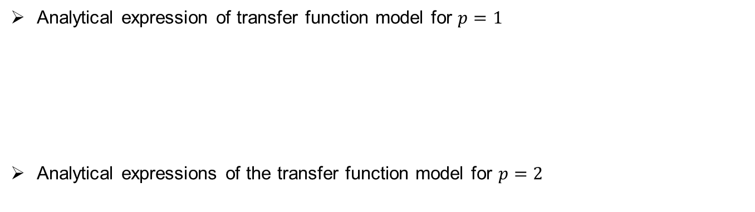
Identification Technique
Analytical expression of transfer function model for $p=1$
Analytical expressions of the transfer function model for $p=2$
$$T_{1}=\frac{\sqrt{{\left(\frac{4hK}{πA_{P}}−1\right)}^{2}}}{ω}$$
$$D=\frac{π−\tan^{−1}\left(ωT_{1}\right)}{ω}$$
$$D=\frac{T\sin^{−1}\left(1−\frac{πAp}{2Kh}\right)}{π}$$
$$T_{1}=\frac{T\tan\left({\left(\frac{πD}{T}−π\right)}/2\right)}{π}$$
4th June 2024
Dept. of EEE, IIT Guwahati
11

Slide 12
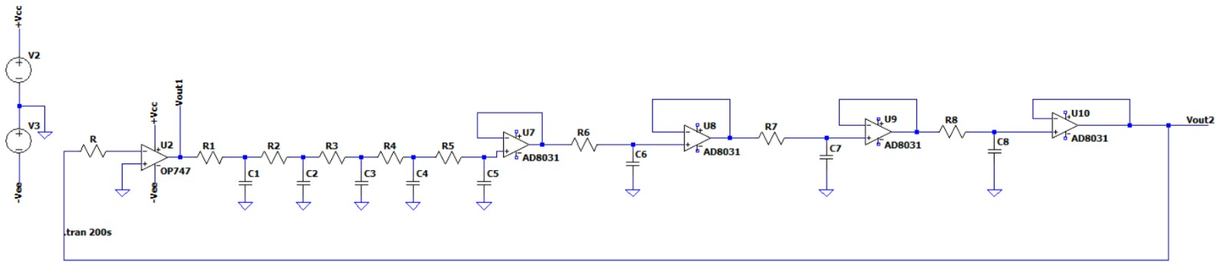
Hardware Implementation
We require a specific hardware circuit to showcase the behaviour of a dynamical systems for parameter identification.
Hardware is developed in three segments
Relay
Process model
Delay
Relay
Process
Delay Circuit
Figure 3: Simulated circuit
4th June 2024
Dept. of EEE, IIT Guwahati
12

Slide 13
Hardware Implementation
Relay
Process
Delay
Relay is designed based on the fundamental principle of a comparator circuit that revolves around comparing a signal voltage at one input of the operational amplifier with a reference voltage.
The process model developed that embodies the system dynamics and is constructed using resistors and capacitors by forming a low-pass filter circuit.
A hardware delay circuit using a voltage buffer amplifier configuration using an AD8031 rail-to-rail operational amplifier known for its high gain bandwidth of 80MHz.
4th June 2024
Dept. of EEE, IIT Guwahati
13

Slide 14
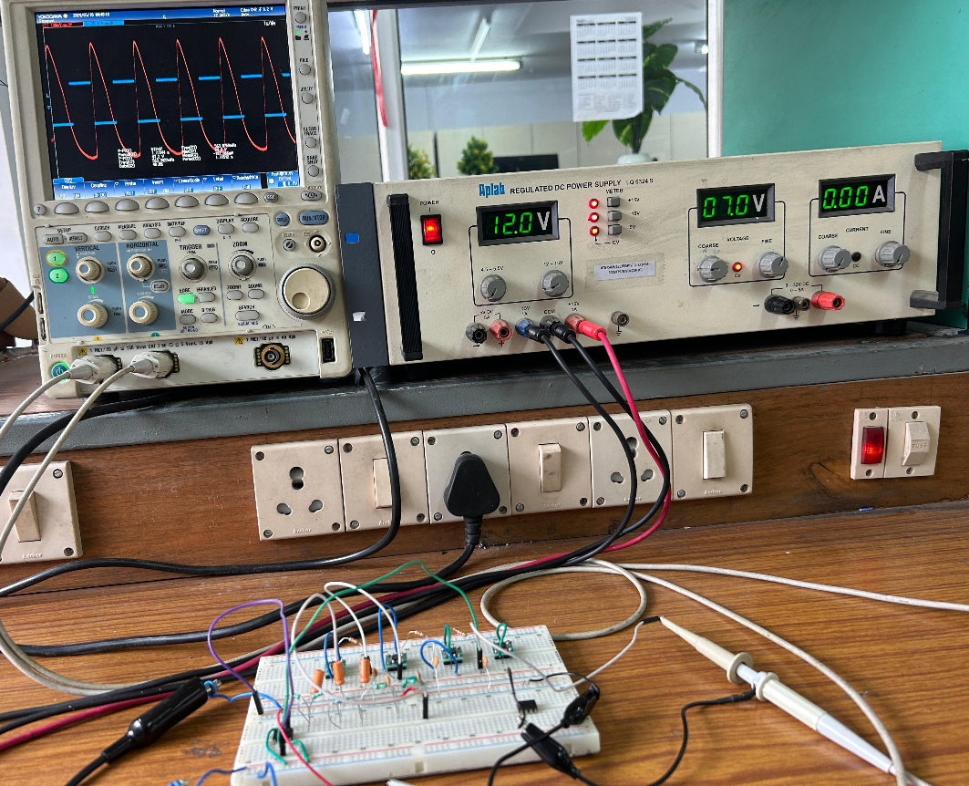
Hardware Implementation
Figure 4: Final hardware circuit implementation setup
4th June 2024
Dept. of EEE, IIT Guwahati
14

Slide 15
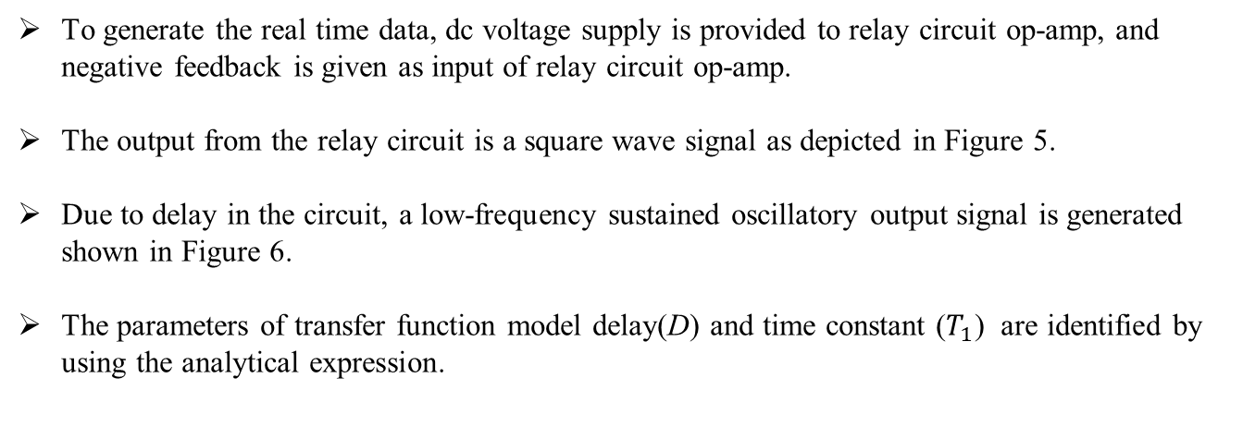
Data Generation & Analysis
To generate the real time data, dc voltage supply is provided to relay circuit op-amp, and negative feedback is given as input of relay circuit op-amp.
The output from the relay circuit is a square wave signal as depicted in Figure 5.
Due to delay in the circuit, a low-frequency sustained oscillatory output signal is generated shown in Figure 6.
The parameters of transfer function model delay(D) and time constant ($T_{1}$) are identified by using the analytical expression.
4th June 2024
Dept. of EEE, IIT Guwahati
15

Slide 16
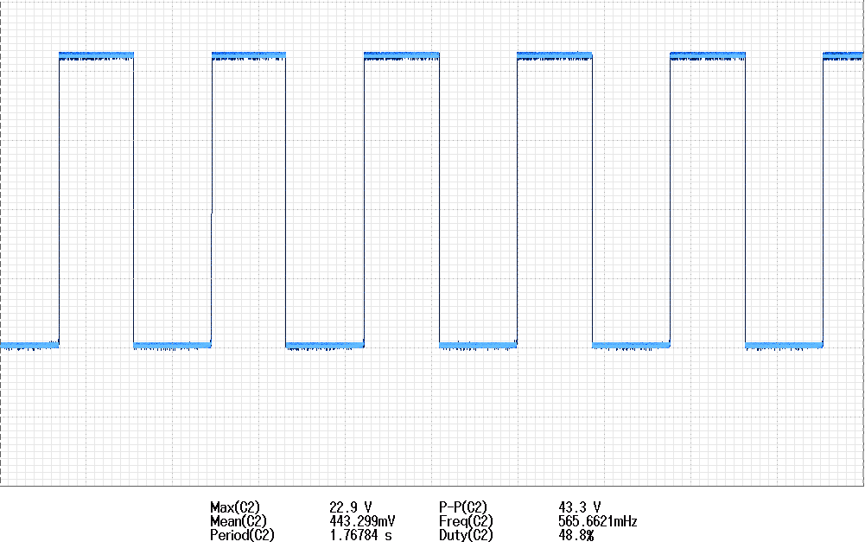
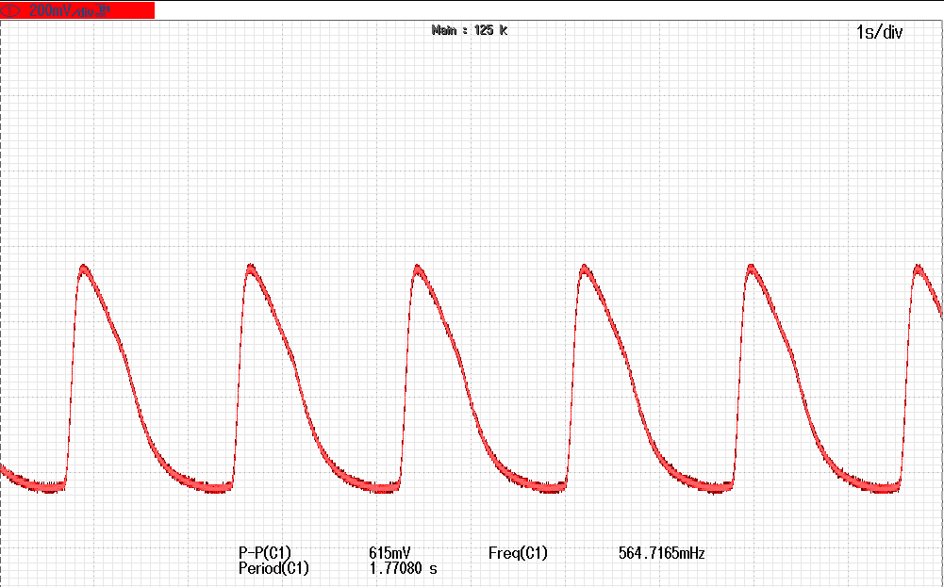
Data Generation & Analysis
Figure 5: Hardware relay o/p signal
Figure 6: Hardware process o/p signal
4th June 2024
Dept. of EEE, IIT Guwahati
16

Slide 17
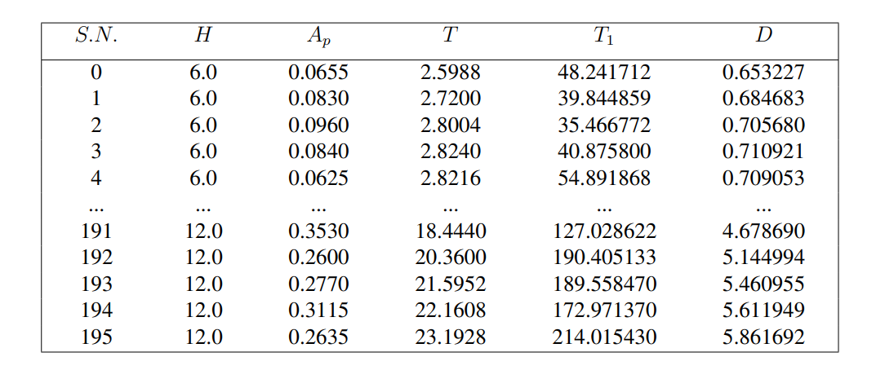
Data Generation & Analysis
Table 1: Dataset of FOPDT transfer function model
4th June 2024
Dept. of EEE, IIT Guwahati
17

Slide 18
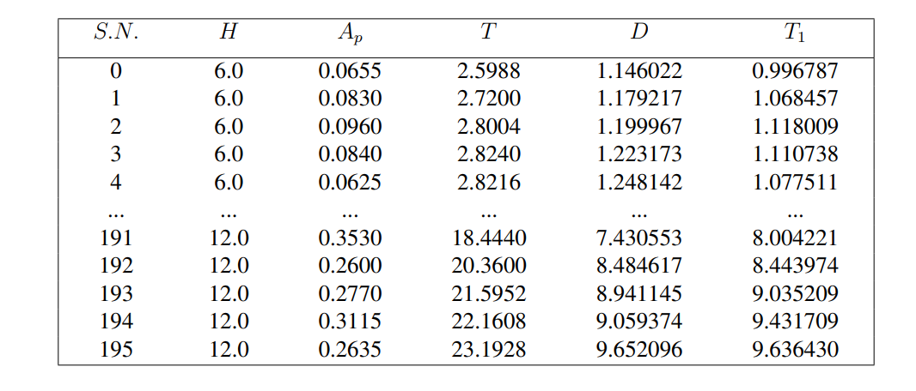
Data Generation & Analysis
Table 2: Dataset of SOPDT transfer function model
4th June 2024
Dept. of EEE, IIT Guwahati
18

Slide 19
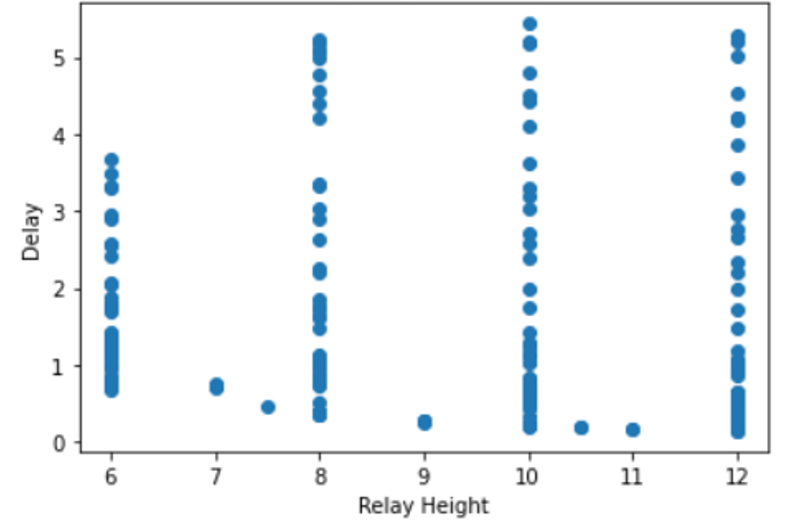
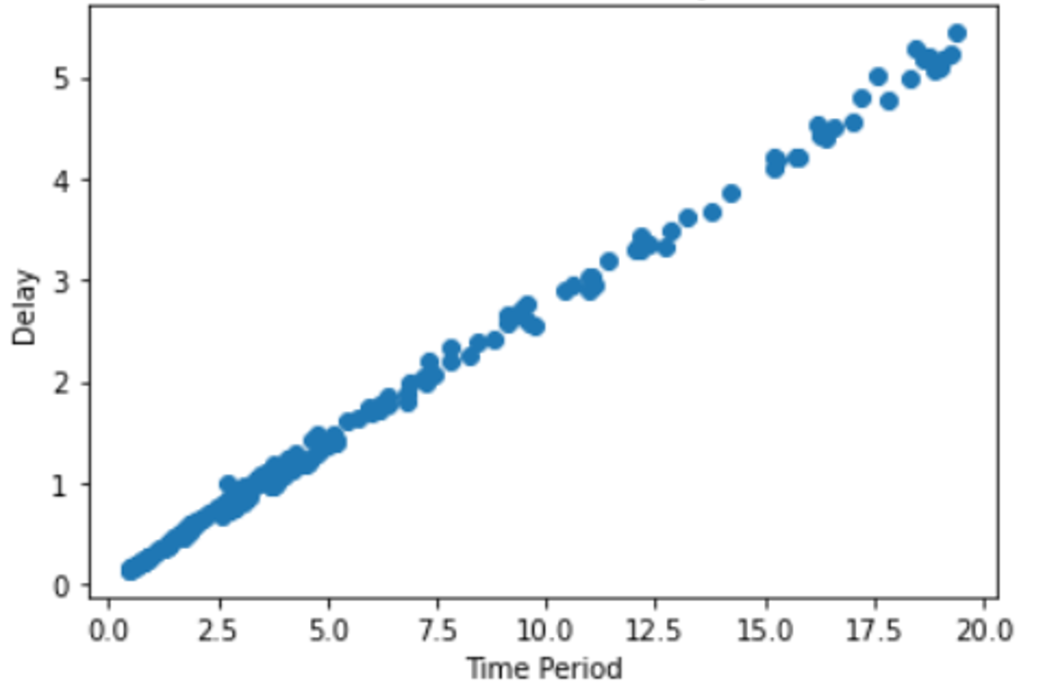
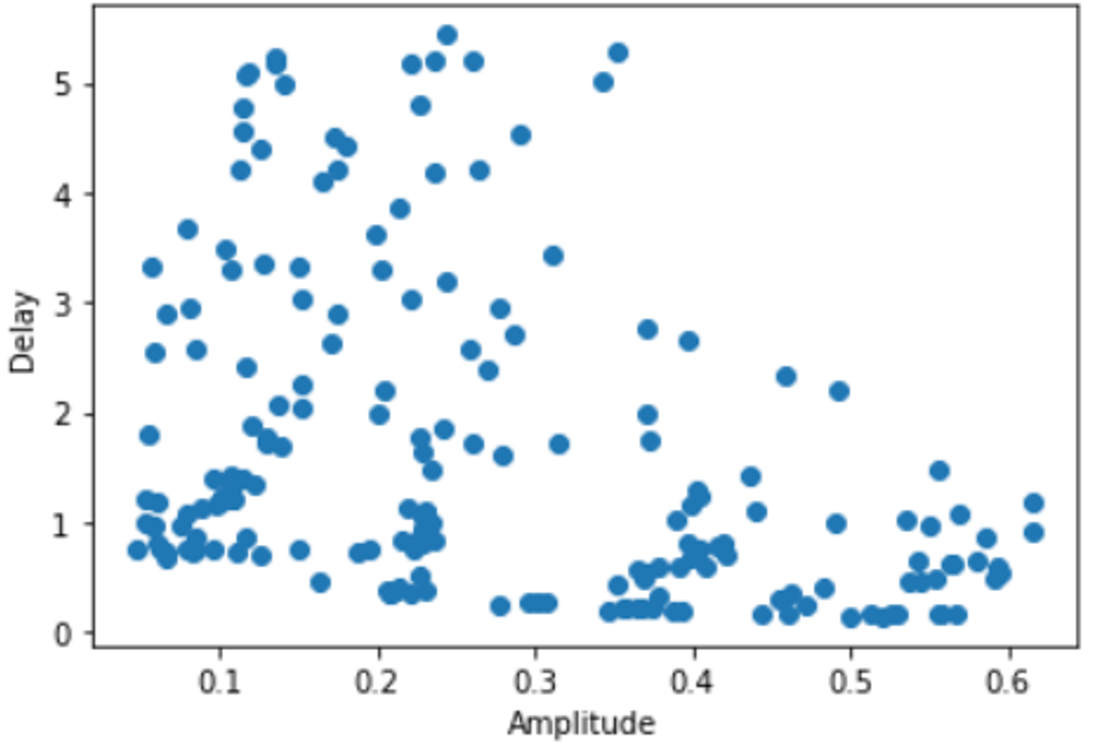
Data Generation & Analysis
Figure 7: Relay height vs Delay
Figure 9: Time Period vs Delay
Figure 8: Amplitude vs Delay
4th June 2024
Dept. of EEE, IIT Guwahati
19

Slide 20
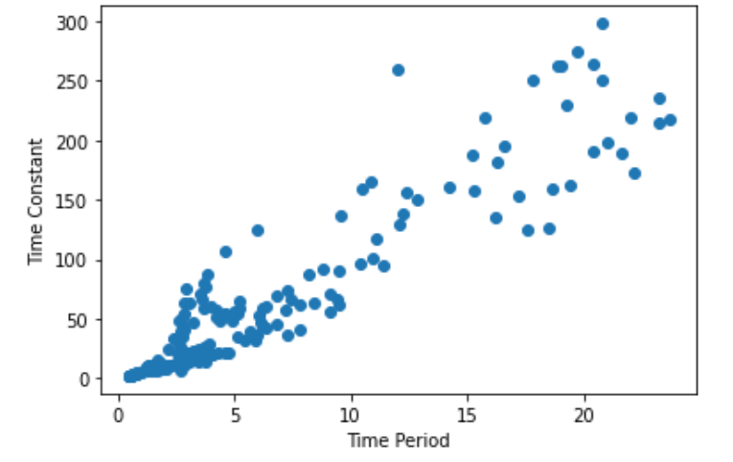
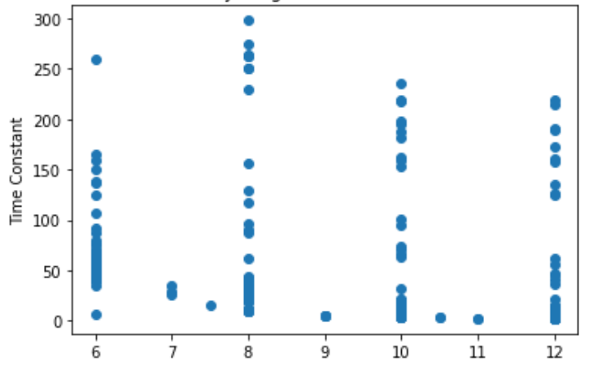
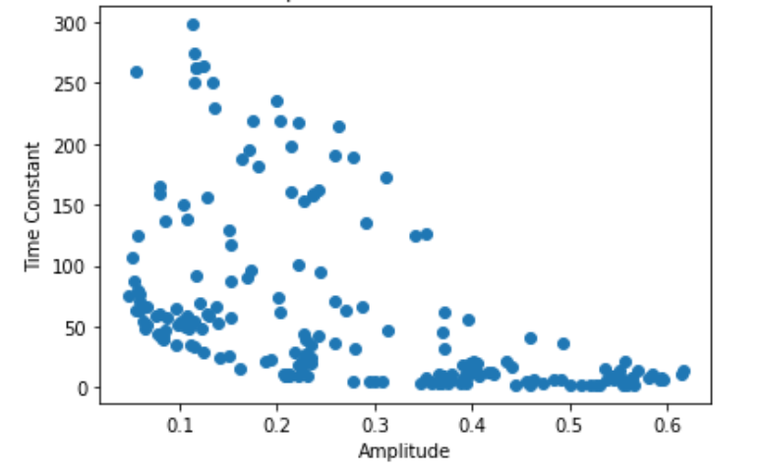
Data Generation & Analysis
Figure 10: Relay Height vs Time constant
Figure 12: Time period vs Time constant
Figure 11: Amplitude vs Time constant
4th June 2024
Dept. of EEE, IIT Guwahati
20

Slide 21
Methodology & Algorithms
Input Data
Identify Key Parameters
Training ML Model
Predicting Target Variable
Primary data set generated from hardware
Relay height, Amplitude,
Time period
KNN,SVR,DT,RF,GBM,XG Boost
Delay , Time Constant
4th June 2024
Dept. of EEE, IIT Guwahati
21

Slide 22
Methodology & Algorithms
Flow Chart
Start
I/p Data Set
Attribute Selection
Training Data Set
Testing Data Set
Cross Validation
Trained function
Algorithms Trained ?
Evaluate Model on Test Data
Yes
Predictive Result
End
No
4th June 2024
Dept. of EEE, IIT Guwahati
22

Slide 23
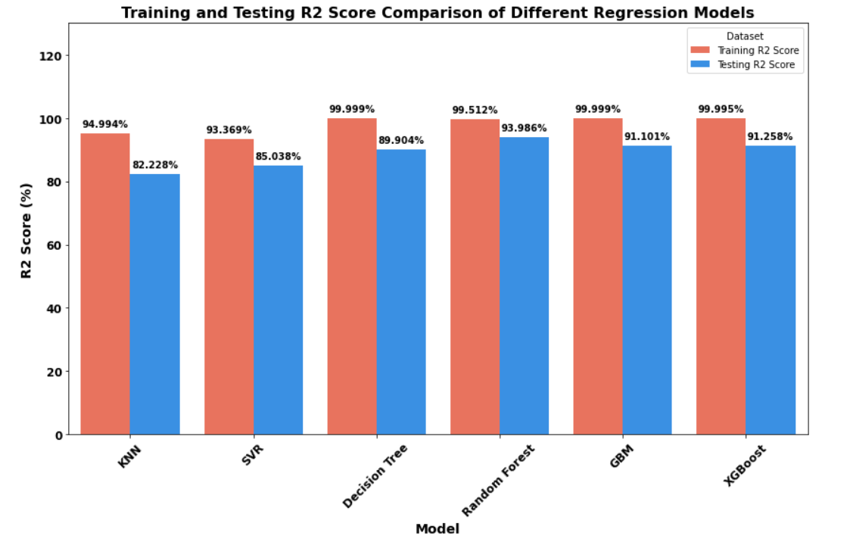
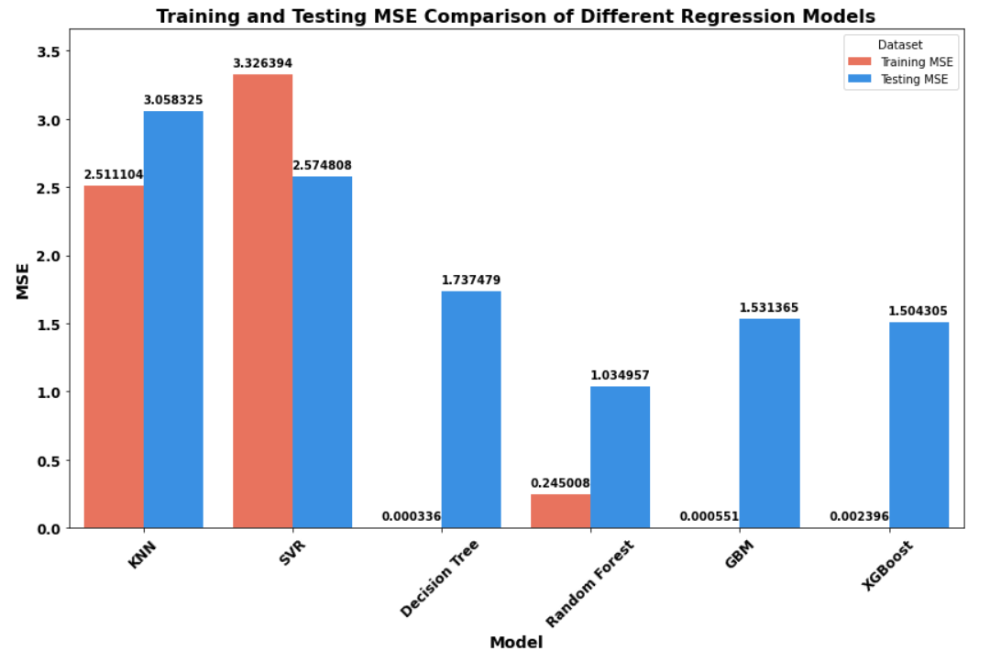
Results
Comparative R2 Score & MSE of Time Constant for FOPDT
4th June 2024
Dept. of EEE, IIT Guwahati
23

Slide 24
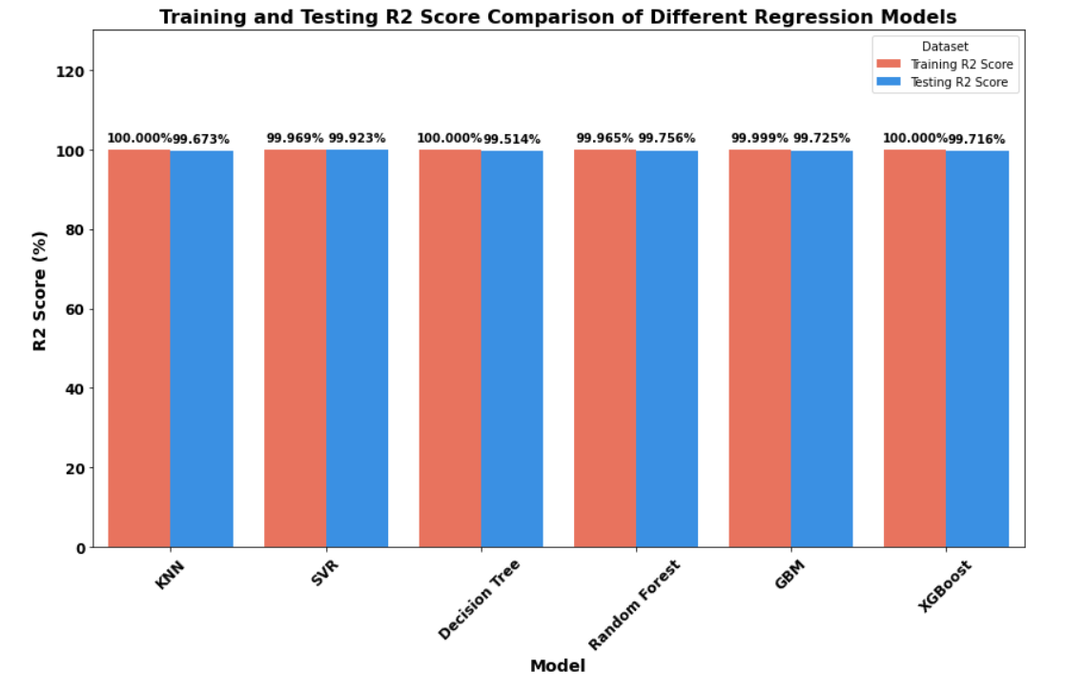
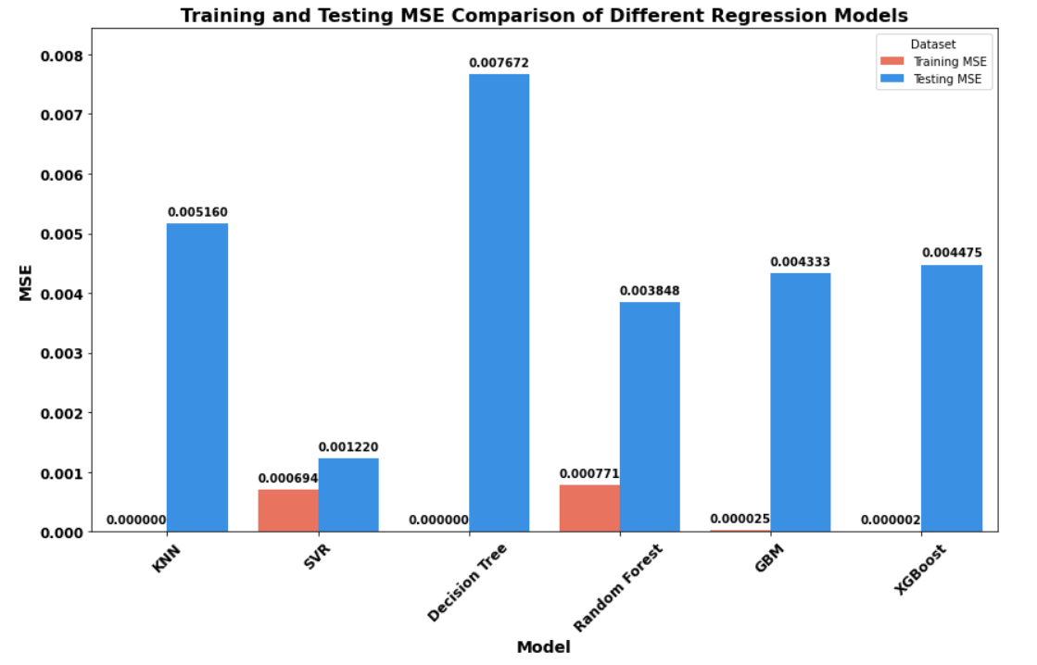
Results
Comparative R2 Score & MSE of Delay for FOPDT
4th June 2024
Dept. of EEE, IIT Guwahati
24

Slide 25
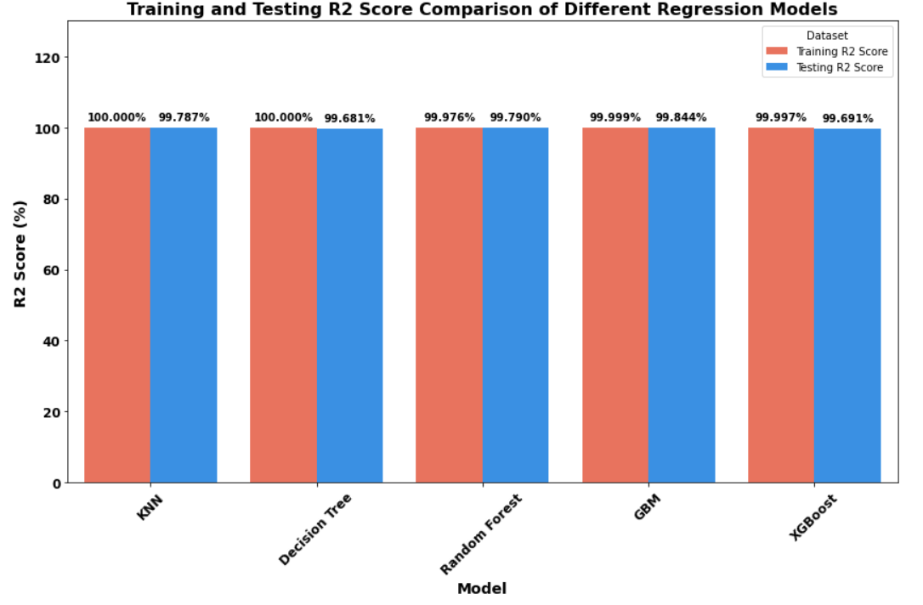
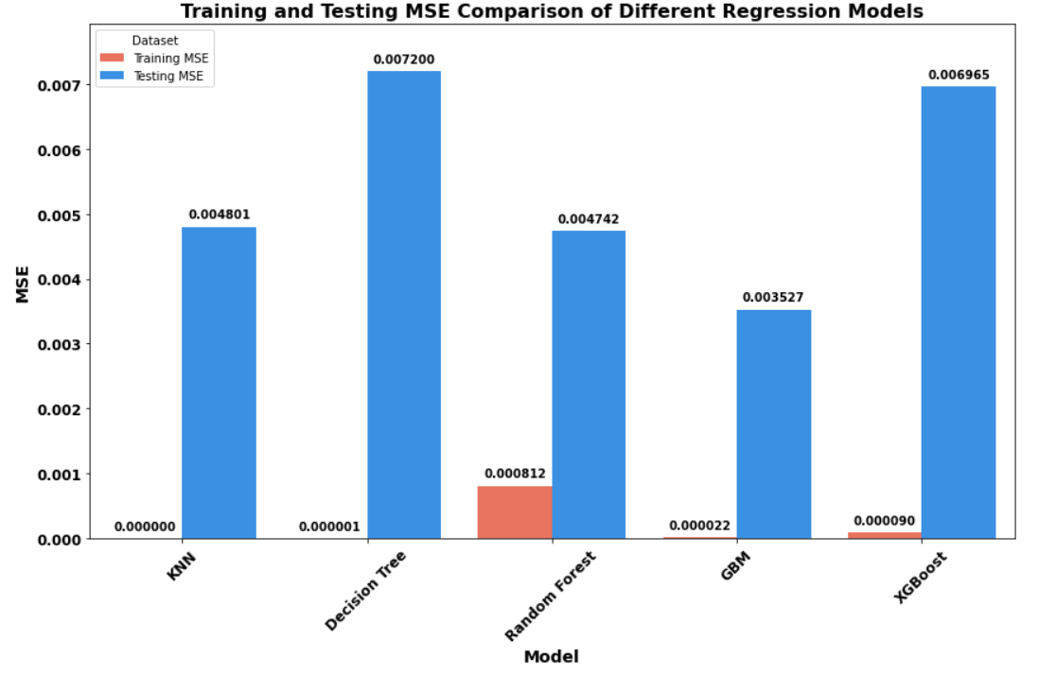
Results
Comparative R2 Score & MSE of Time Constant for SOPDT
4th June 2024
Dept. of EEE, IIT Guwahati
25

Slide 26
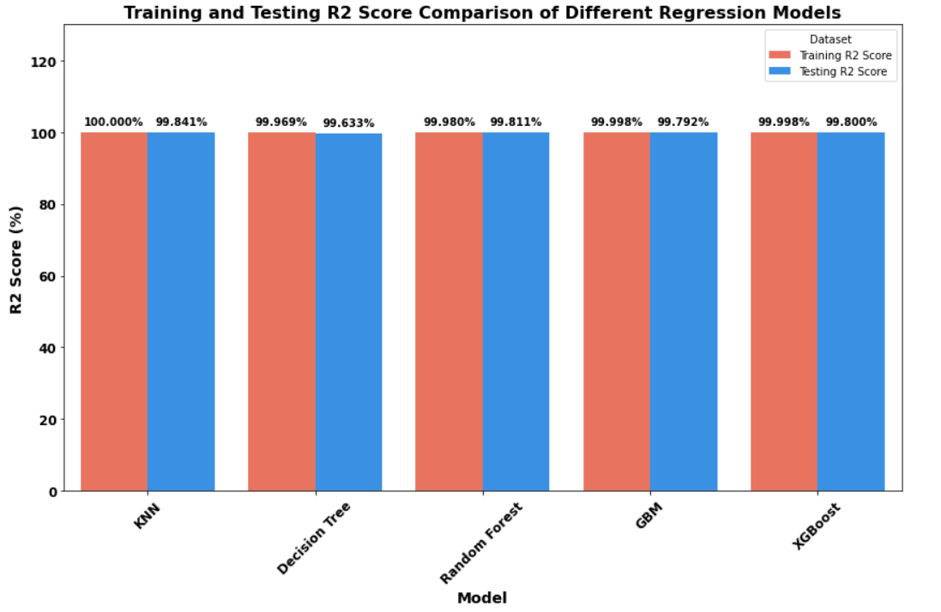
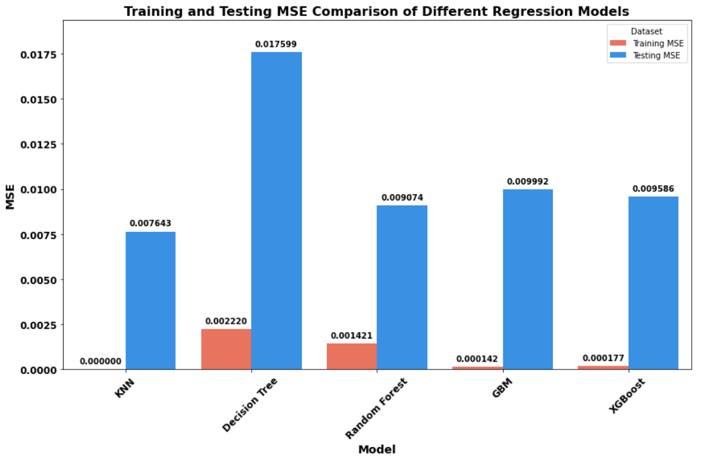
Results
Comparative R2 Score & MSE of Delay for SOPDT
4th June 2024
Dept. of EEE, IIT Guwahati
26

Slide 27


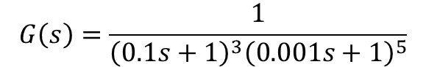
Results
Example 1 :
Real - time system transfer function
$$G\left(s\right)=\frac{1}{{\left(0.1s+1\right)}^{3}{\left(0.001s+1\right)}^{5}}$$
Real-time system identified as stable FOPDT using relay control system
$$G_{1}\left(s\right)=\frac{e^{−1.017s}}{\left(18.879s+1\right)}$$
Real-time system identified as stable FOPDT using proposed method
$$G_{2}\left(s\right)=\frac{e^{−1.2101s}}{\left(18.2042s+1\right)}$$
4th June 2024
Dept. of EEE, IIT Guwahati
27

Slide 28
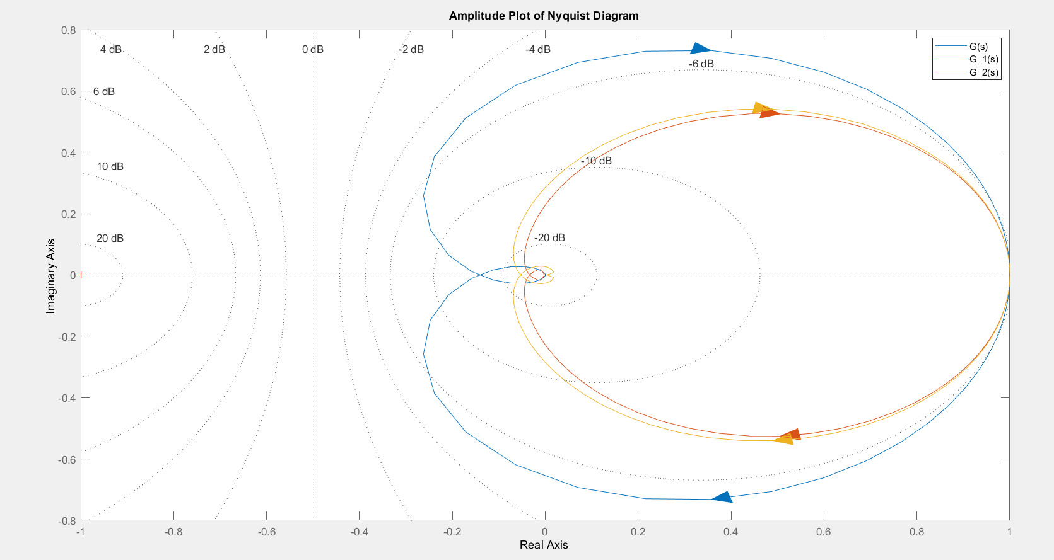
Results
Figure 13 : Nyquist plot of the actual and identified model TF for Example 1
4th June 2024
Dept. of EEE, IIT Guwahati
28

Slide 29


Results
Example 2 :
Real - time system transfer function
$$G\left(s\right)=\frac{1}{{\left(0.1s+1\right)}^{3}{\left(0.001s+1\right)}^{5}}$$
Real-time system identified as stable SOPDT using relay control system
$$G_{1}\left(s\right)=\frac{e^{−0.8925s}}{{\left(0.9025s+1\right)}^{2}}$$
Real-time system identified as stable SOPDT using proposed method
$$G_{2}\left(s\right)=\frac{e^{−0.8221s}}{{\left(1.0069s+1\right)}^{2}}$$
4th June 2024
Dept. of EEE, IIT Guwahati
29

Slide 30
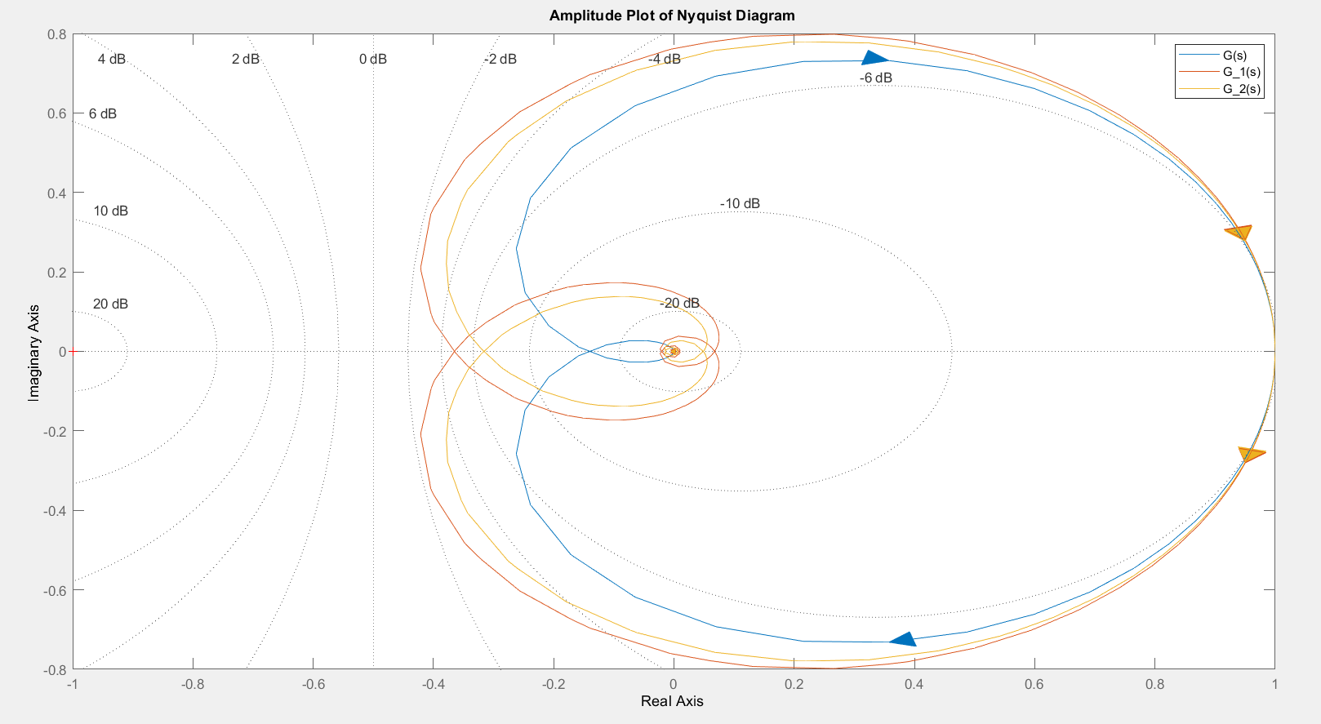
Results
Figure 14: Nyquist plot of the actual and identified model TF for Example 2
4th June 2024
Dept. of EEE, IIT Guwahati
30

Slide 31
Conclusion and Future Scope
A hardware model is constructed with physical delay, and real-time data have been collected to make the proposed method more accurate for real time system identifications and autotune the controllers precisely.
01
Conclusion
A ML-based method is implemented to model the complex higher-order systems to FOPDT models with reduced identification error & simple experiments without mathematical computation.
02
03
Finally, it concludes that the proposed method provides better estimation accuracy with real-time data.
4th June 2024
Dept. of EEE, IIT Guwahati
31

Slide 32
Conclusion and Future Scope
Future
Scope
Implement PID controller in hardware.
Extend ML algorithms for online autotuning of controllers.
4th June 2024
Dept. of EEE, IIT Guwahati
32

Slide 33
References
[1] W. Li, E. Eskinat, and W. L. Luyben, “ An Improved Autotune Identification Method,” Ind. Eng. Chem. Res., Vol. 30, 1991.
[2] A. Kumar and P. K. Padhy, "Relay Based Identification for FOPDT System & Comparison on Measurement Accuracy & Sensitivity Analysis, “ 2021 1st International Conference on Power Electronics and Energy (ICPEE), 2021.
[3] Bajrangbali and S. Majhi, “Relay Based Identification of Systems,” International Journal of Scientific & Engineering Research, Volume 3,
(ISSN 2229-5518), 2012.
[4] Thyagarajan, T and Yu, Cheng-Ching,”Improved autotuning using the shape factor from relay feedback”, Journal of Industrial & engineering chemistry research, Volume-42, 2003.
4th June 2024
Dept. of EEE, IIT Guwahati
33

Slide 34


